Slide 1
RUSTikales Rust for beginners
©Philippe Felix Haupt 2023-2024

Slide 2
Plan for today
©Philippe Felix Haupt 2023-2024

Slide 3
Plan for today
Recap
©Philippe Felix Haupt 2023-2024

Slide 4
Plan for today
Recap
cargo
©Philippe Felix Haupt 2023-2024

Slide 5
Plan for today
Recap
cargo
Q/A
©Philippe Felix Haupt 2023-2024

Slide 6
Recap
©Philippe Felix Haupt 2023-2024

Slide 7
Recap
Ownership
Borrowing
Borrow Checker
©Philippe Felix Haupt 2023-2024

Slide 8
Recap
Ownership
Borrowing
Borrow Checker
Enums
Pattern Matching
Generic Types
©Philippe Felix Haupt 2023-2024

Slide 9
Recap
Ownership
Borrowing
Borrow Checker
Enums
Pattern Matching
Generic Types
Option<T>
Every type in Rust has a value, there is no null
Option::None → Field/Variable has no value
Option::Some(T) → Field/Variable has a value
©Philippe Felix Haupt 2023-2024

Slide 10
Recap
Ownership
Borrowing
Borrow Checker
Enums
Pattern Matching
Generic Types
Option<T>
Result<T, E>
Rust’s way of Error handling
Result::Ok(T) → Everything is fine, no error happened
Result::Err(E) → An error occurred
©Philippe Felix Haupt 2023-2024

Slide 11
Recap
Ownership
Borrowing
Borrow Checker
Enums
Pattern Matching
Generic Types
Option<T>
Result<T, E>
To get the underlying data of Option and Result, you need to either unwrap, or pattern match the Enum values
©Philippe Felix Haupt 2023-2024

Slide 12
cargo
©Philippe Felix Haupt 2023-2024

Slide 13
cargo
So far, everything we covered was part of the Rust programming language
©Philippe Felix Haupt 2023-2024

Slide 14
cargo
So far, everything we covered was part of the Rust programming language
The Rust grammar allows us to write anything we covered, from loops to recursive Enums, and the Compiler will translate our code into an executable
©Philippe Felix Haupt 2023-2024

Slide 15
cargo
So far, everything we covered was part of the Rust programming language
The Rust grammar allows us to write anything we covered, from loops to recursive Enums, and the Compiler will translate our code into an executable
Today, we’ll step away from the language and look at the toolchain behind Rust, which consists of many parts:
rustup
rustc
rustdoc
cargo
rust-analyzer
©Philippe Felix Haupt 2023-2024

Slide 16
cargo
So far, everything we covered was part of the Rust programming language
The Rust grammar allows us to write anything we covered, from loops to recursive Enums, and the Compiler will translate our code into an executable
Today, we’ll step away from the language and look at the toolchain behind Rust, which consists of many parts:
rustup
rustc
rustdoc
cargo
rust-analyzer
More specifically, we’ll talk about cargo, and what role it plays
©Philippe Felix Haupt 2023-2024

Slide 17
cargo
rustup is the manager for the Rust language
Manages the toolchains, and allows you to set different compilation targets
©Philippe Felix Haupt 2023-2024

Slide 18
cargo
rustup is the manager for the Rust language
Manages the toolchains, and allows you to set different compilation targets
rustc is the actual Rust compiler
It takes your source code, and converts it to an executable
©Philippe Felix Haupt 2023-2024

Slide 19
cargo
rustup is the manager for the Rust language
Manages the toolchains, and allows you to set different compilation targets
rustc is the actual Rust compiler
It takes your source code, and converts it to an executable
rustdoc generates Webpages for your projects
Very nice utility for big projects which are used by other people
©Philippe Felix Haupt 2023-2024

Slide 20
cargo
rustup is the manager for the Rust language
Manages the toolchains, and allows you to set different compilation targets
rustc is the actual Rust compiler
It takes your source code, and converts it to an executable
rustdoc generates Webpages for your projects
Very nice utility for big projects which are used by other people
cargo is the package manager
Libraries, distributed binaries, dependencies are all resolved with cargo
©Philippe Felix Haupt 2023-2024

Slide 21
cargo
rustup is the manager for the Rust language
Manages the toolchains, and allows you to set different compilation targets
rustc is the actual Rust compiler
It takes your source code, and converts it to an executable
rustdoc generates Webpages for your projects
Very nice utility for big projects which are used by other people
cargo is the package manager
Libraries, distributed binaries, dependencies are all resolved with cargo
rust-analyzer is part of the IDE integration
Red wiggly lines of doom, right in your IDE, without compiling the code yourself :^)
©Philippe Felix Haupt 2023-2024

Slide 22
cargo
cargo itself is just a wrapper for most things we could’ve done ourselves
©Philippe Felix Haupt 2023-2024

Slide 23
cargo
cargo itself is just a wrapper for most things we could’ve done ourselves
Most commands call to other tools, cargo build also simply runs rustc
©Philippe Felix Haupt 2023-2024

Slide 24
cargo
cargo itself is just a wrapper for most things we could’ve done ourselves
Most commands call to other tools, cargo build also simply runs rustc
In fact, all of the previous exercises and sessions could’ve been done purely with rustc, without any cargo at all
©Philippe Felix Haupt 2023-2024

Slide 25
cargo
cargo itself is just a wrapper for most things we could’ve done ourselves
Most commands call to other tools, cargo build also simply runs rustc
In fact, all of the previous exercises and sessions could’ve been done purely with rustc, without any cargo at all
However, cargo makes a lot of things more convenient, and easier:
cargo build/run takes up all the work of including files, creating executables, and passing instructions to rustc
©Philippe Felix Haupt 2023-2024

Slide 26
cargo
cargo itself is just a wrapper for most things we could’ve done ourselves
Most commands call to other tools, cargo build also simply runs rustc
In fact, all of the previous exercises and sessions could’ve been done purely with rustc, without any cargo at all
However, cargo makes a lot of things more convenient, and easier:
cargo build/run takes up all the work of including files, creating executables, and passing instructions to rustc
Where cargo is 100% required is when we want to add dependencies to our project, for example external libraries
©Philippe Felix Haupt 2023-2024

Slide 27
cargo
cargo is the package manager of Rust, which means:
it keeps track of all packages
it knows where to find the code for the packages
it knows how to include that code into your project, so it compiles successfully
©Philippe Felix Haupt 2023-2024

Slide 28
cargo
cargo is the package manager of Rust, which means:
it keeps track of all packages
it knows where to find the code for the packages
it knows how to include that code into your project, so it compiles successfully
There are many packages that can be included in a project:
Your own packages created using cargo new
Packages that other people published using cargo publish
©Philippe Felix Haupt 2023-2024

Slide 29
cargo
cargo is the package manager of Rust, which means:
it keeps track of all packages
it knows where to find the code for the packages
it knows how to include that code into your project, so it compiles successfully
There are many packages that can be included in a project:
Your own packages created using cargo new
Packages that other people published using cargo publish
This is when Cargo.toml enters the playing field
©Philippe Felix Haupt 2023-2024

Slide 30
cargo
Today, we’ll do something random:
©Philippe Felix Haupt 2023-2024

Slide 31
cargo
Today, we’ll do something random:
Using the rand package, and the graphics library raylib, we’ll implement Game Of Life
©Philippe Felix Haupt 2023-2024

Slide 32
cargo
Today, we’ll do something random:
Using the rand package, and the graphics library raylib, we’ll implement Game Of Life
rand allows us to generate random numbers
it’s not part of the standard library, so we need to import it
raylib allows us to easily create a window and draw on it
so we’re not limited to the console anymore
©Philippe Felix Haupt 2023-2024

Slide 33
cargo
To start, we need to create a new project as usual:
cargo new <project_name>
©Philippe Felix Haupt 2023-2024

Slide 34

cargo
To start, we need to create a new project as usual:
cargo new <project_name>
Executable, other option would’ve been library
©Philippe Felix Haupt 2023-2024

Slide 35
cargo
To start, we need to create a new project as usual:
cargo new <project_name>
If we now run the code using cargo run, we get the usual “Hello, world!” output
©Philippe Felix Haupt 2023-2024

Slide 36
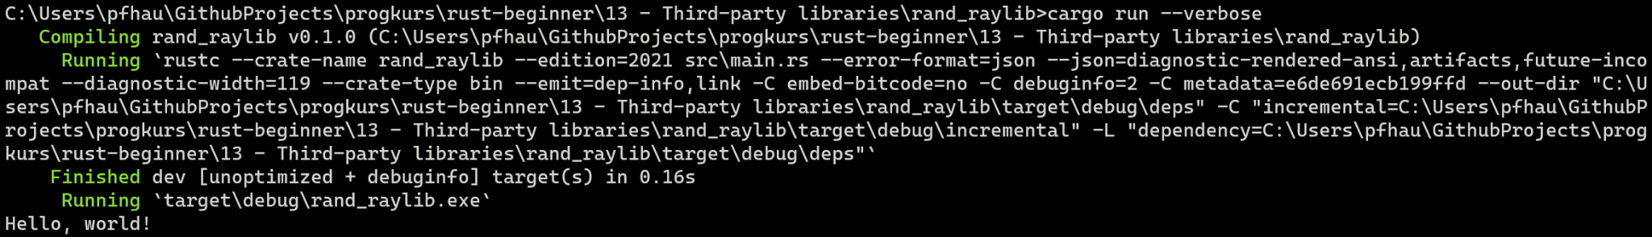
cargo
To start, we need to create a new project as usual:
cargo new <project_name>
If we now run the code using cargo run, we get the usual “Hello, world!” output
To show what work cargo does in the background, we can add the flag --verbose:
©Philippe Felix Haupt 2023-2024

Slide 37
cargo
rustc :)
To start, we need to create a new project as usual:
cargo new <project_name>
If we now run the code using cargo run, we get the usual “Hello, world!” output
To show what work cargo does in the background, we can add the flag --verbose:
our code :^)
©Philippe Felix Haupt 2023-2024

Slide 38
cargo
To start, we need to create a new project as usual:
cargo new <project_name>
If we now run the code using cargo run, we get the usual “Hello, world!” output
To show what work cargo does in the background, we can add the flag --verbose
Now, we need to add the packages to our project, so we can use them
©Philippe Felix Haupt 2023-2024

Slide 39
cargo
To start, we need to create a new project as usual:
cargo new <project_name>
If we now run the code using cargo run, we get the usual “Hello, world!” output
To show what work cargo does in the background, we can add the flag --verbose
Now, we need to add the packages to our project, so we can use them
There are two ways to do that:
cargo add <package_name>
Manually modify Cargo.toml
©Philippe Felix Haupt 2023-2024

Slide 40
cargo
To start, we need to create a new project as usual:
cargo new <project_name>
If we now run the code using cargo run, we get the usual “Hello, world!” output
To show what work cargo does in the background, we can add the flag --verbose
Now, we need to add the packages to our project, so we can use them
There are two ways to do that:
cargo add <package_name>
Manually modify Cargo.toml
But how do we know how the package is called, how do we know what to include?
©Philippe Felix Haupt 2023-2024

Slide 41
cargo
To start, we need to create a new project as usual:
cargo new <project_name>
If we now run the code using cargo run, we get the usual “Hello, world!” output
To show what work cargo does in the background, we can add the flag --verbose
Now, we need to add the packages to our project, so we can use them
There are two ways to do that:
cargo add <package_name>
Manually modify Cargo.toml
But how do we know how the package is called, how do we know what to include?
All released packages can be browsed on crates.io
On there, you can easily see how to add a package
©Philippe Felix Haupt 2023-2024

Slide 42
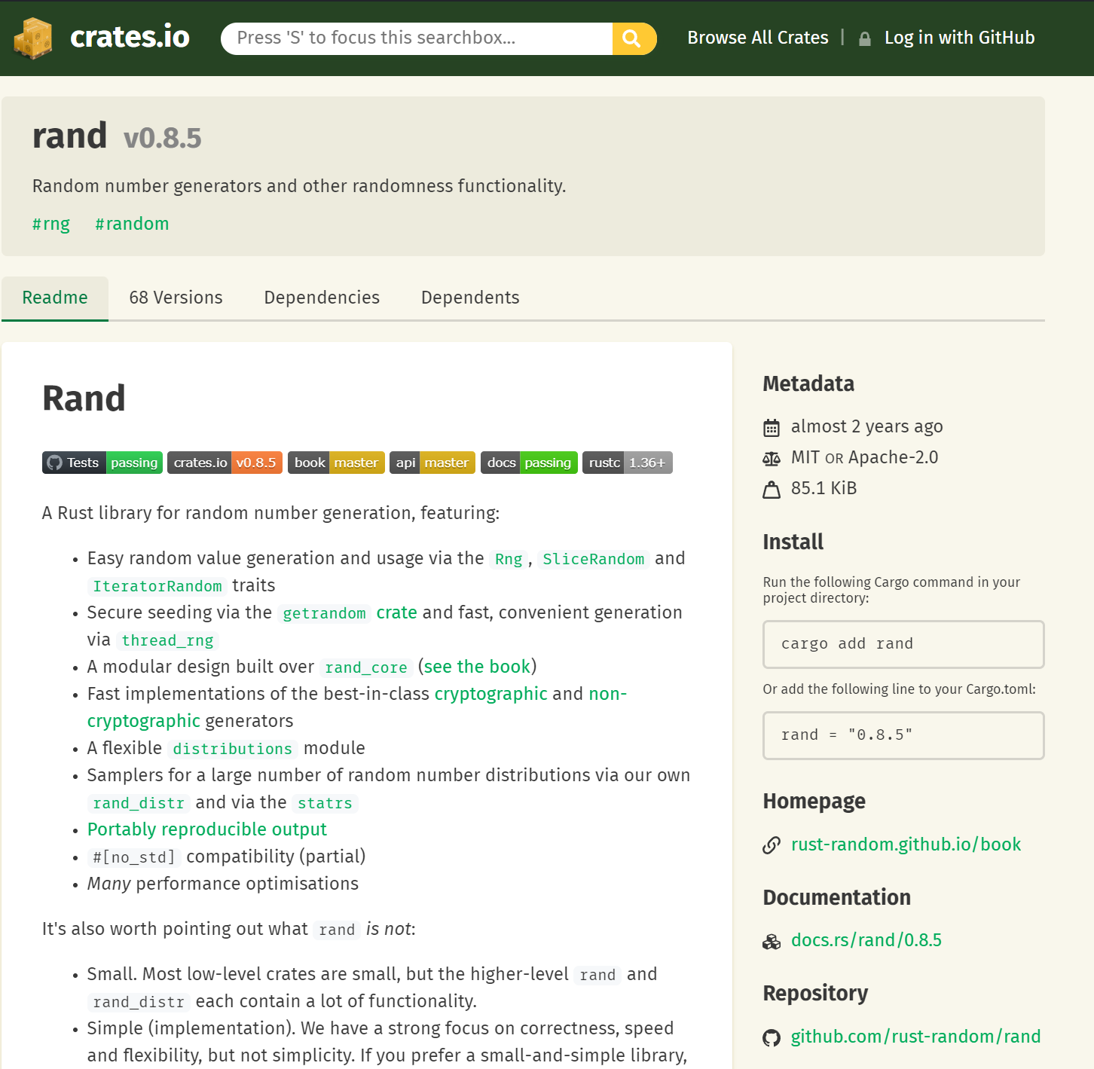
©Philippe Felix Haupt 2023-2024

Slide 43
short description
©Philippe Felix Haupt 2023-2024

Slide 44
README
©Philippe Felix Haupt 2023-2024

Slide 45
Useful links
©Philippe Felix Haupt 2023-2024

Slide 46
Installation :)
©Philippe Felix Haupt 2023-2024

Slide 47
Add dependencies directly,
gets the latest release
©Philippe Felix Haupt 2023-2024

Slide 48
Specify a concrete version,
for example compatibility with other crates
©Philippe Felix Haupt 2023-2024

Slide 49
Add dependencies directly,
gets the latest release
Specify a concrete version,
for example compatibility with other crates
It doesn’t matter which option you choose, all dependencies are handled via Cargo.toml and can be changed at any time
©Philippe Felix Haupt 2023-2024

Slide 50
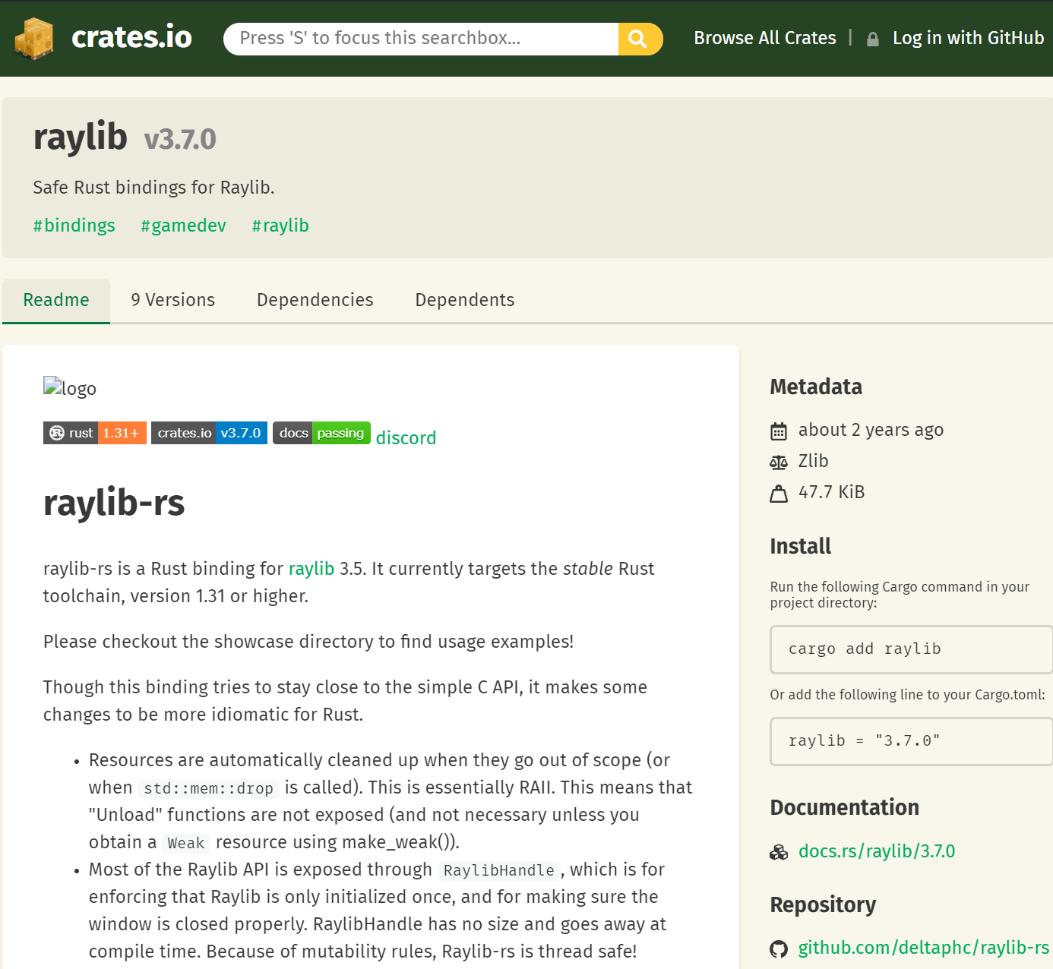
Also need to add this to our Cargo.toml
©Philippe Felix Haupt 2023-2024

Slide 51
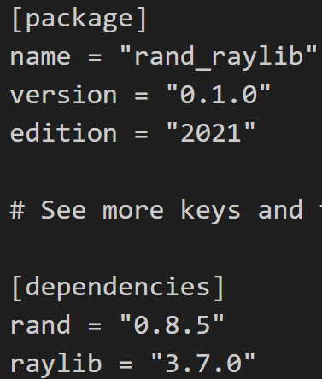
cargo
If done successfully, your Cargo.toml should look like this:
©Philippe Felix Haupt 2023-2024

Slide 52
cargo
If done successfully, your Cargo.toml should look like this:
This is everything cargo needs to properly import and build everything the next time you run cargo build/run
©Philippe Felix Haupt 2023-2024

Slide 53
cargo
We can now use the packages, and work with them
©Philippe Felix Haupt 2023-2024

Slide 54
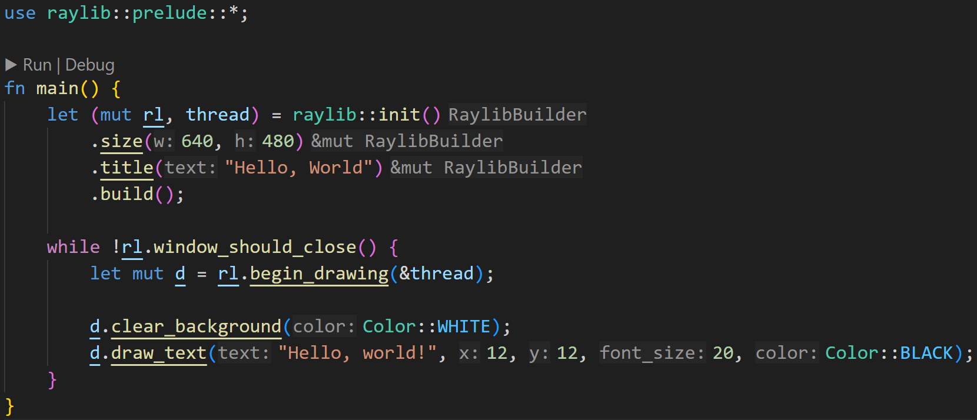
cargo
©Philippe Felix Haupt 2023-2024

Slide 55
cargo
Without use we’d always have to specify the full module path
For example, use std::fmt::Debug; allows us to write
impl Debug for … instead of impl std::fmt::Debug for …
©Philippe Felix Haupt 2023-2024

Slide 56
cargo
Most packages come with a prelude, usually it makes sense to import everything it offers using the wildcard *
©Philippe Felix Haupt 2023-2024

Slide 57
cargo
We create a window here of size 640x480
©Philippe Felix Haupt 2023-2024

Slide 58
cargo
Drawing loop
white background
Show “Hello, world!” on screen
©Philippe Felix Haupt 2023-2024

Slide 59
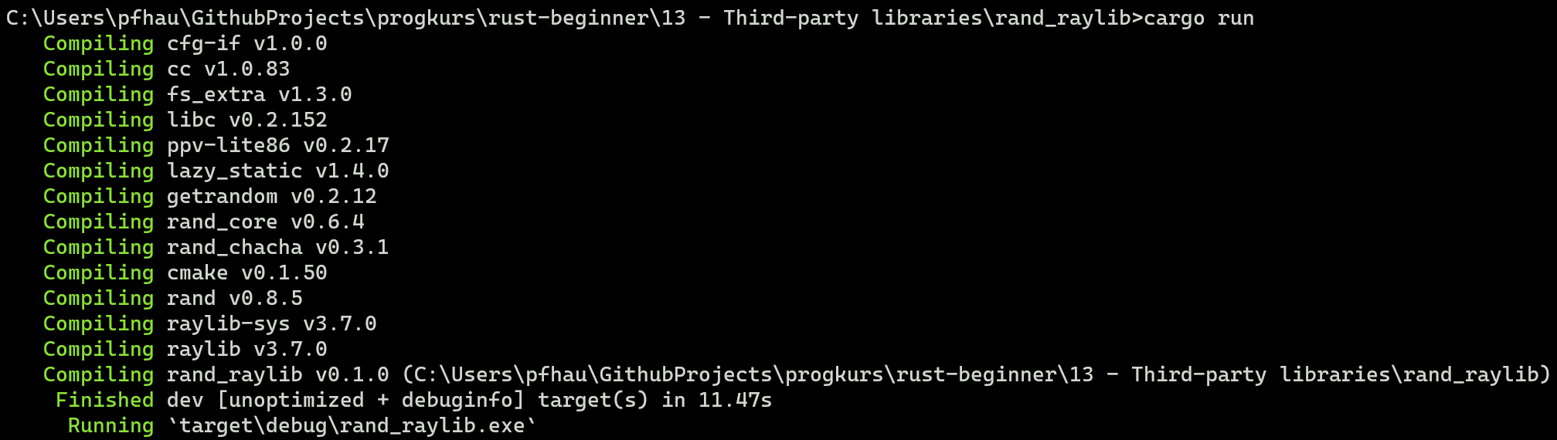
cargo
Executing cargo run now shows us the following:
©Philippe Felix Haupt 2023-2024

Slide 60
cargo
Executing cargo run now shows us the following:
2/3
Why does cargo compile more than two packages?
©Philippe Felix Haupt 2023-2024

Slide 61
cargo
Executing cargo run now shows us the following:
2/3
Why does cargo compile more than two packages?
Answer: Packages themselves can depend on other packages too :)
©Philippe Felix Haupt 2023-2024

Slide 62
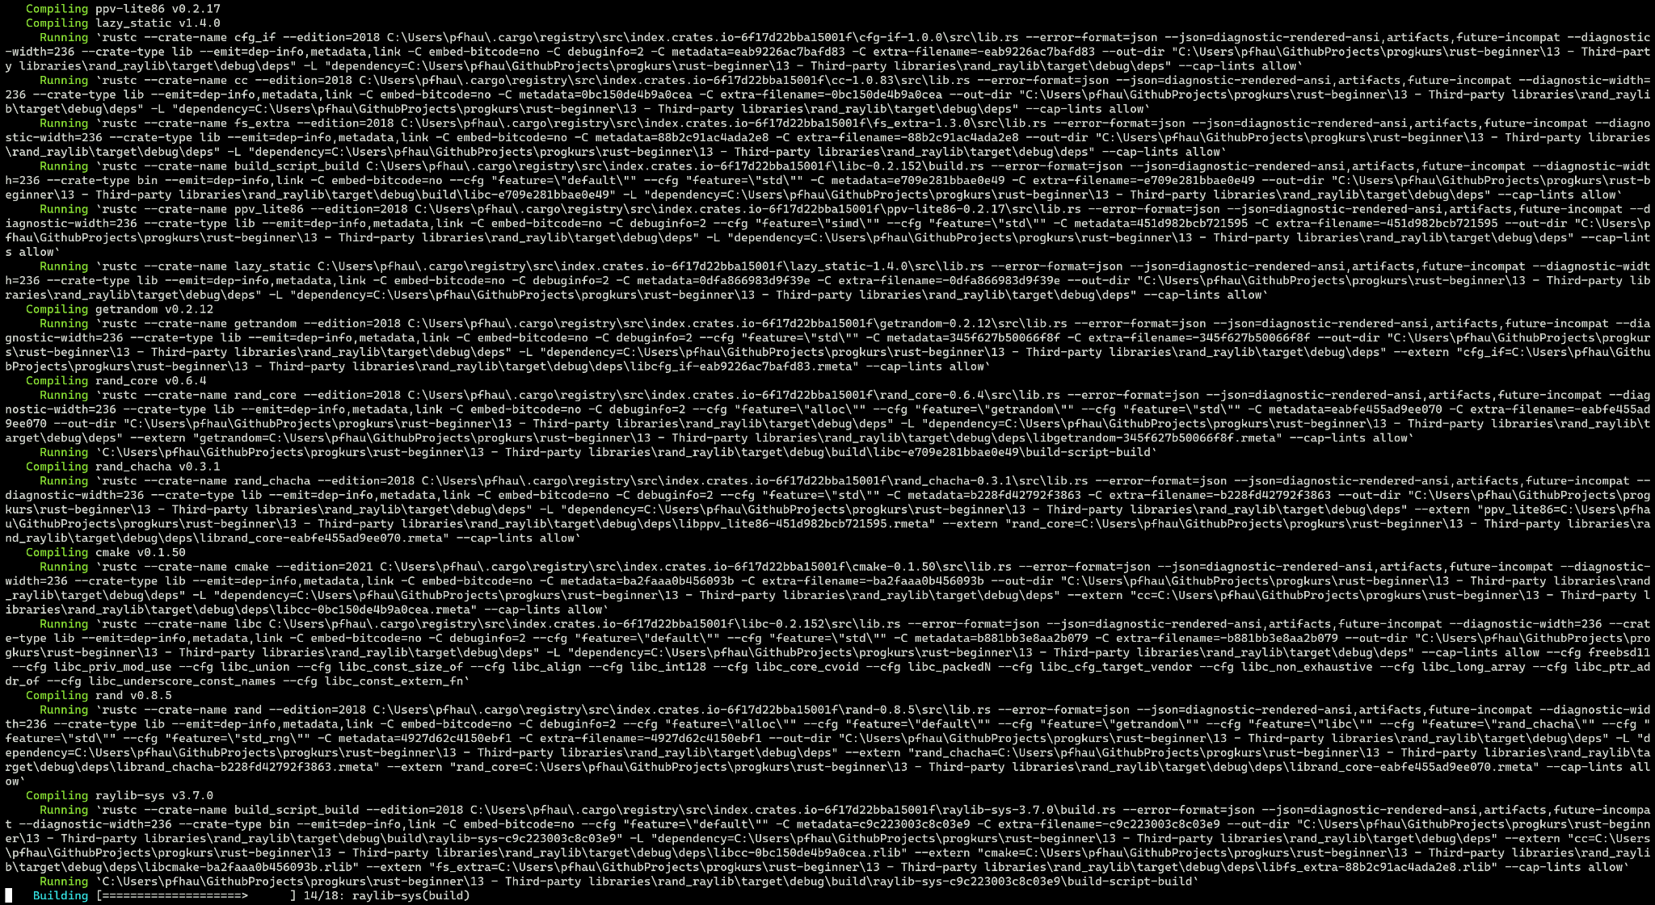
cargo
Executing cargo run –verbose now shows us the following :^) A lot of work
©Philippe Felix Haupt 2023-2024

Slide 63
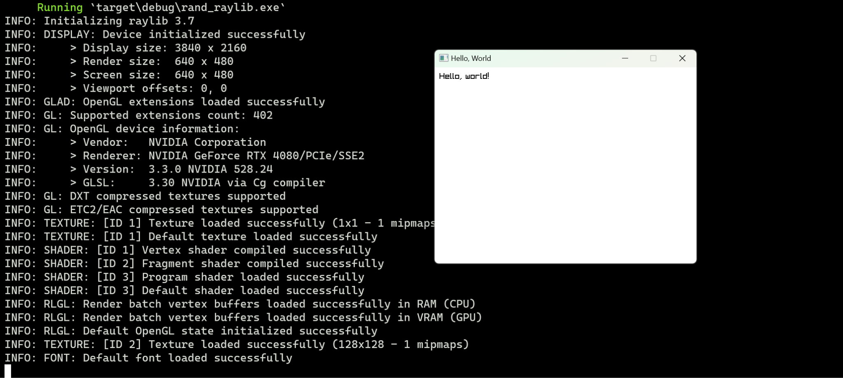
cargo
The output of our program, if done correctly, looks like this:
©Philippe Felix Haupt 2023-2024

Slide 64
cargo
The output of our program, if done correctly, looks like this:
raylib info
©Philippe Felix Haupt 2023-2024

Slide 65
cargo
The output of our program, if done correctly, looks like this:
our window :D
©Philippe Felix Haupt 2023-2024

Slide 66
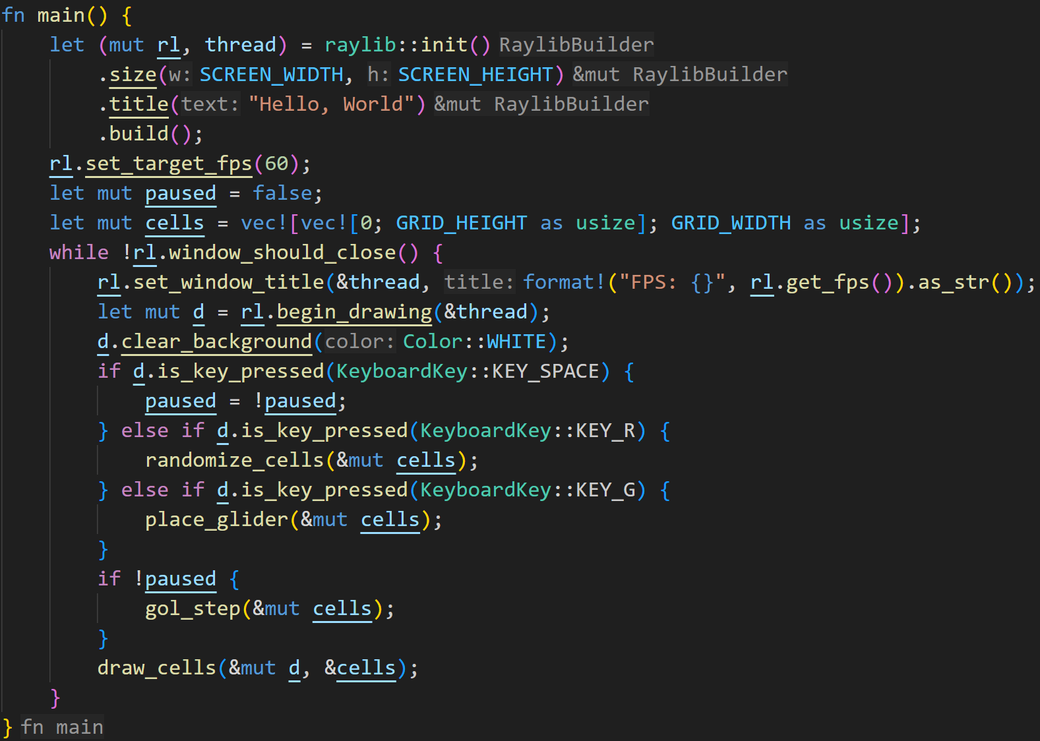
cargo
We can now add the Game Of Life logic to our main loop:
©Philippe Felix Haupt 2023-2024

Slide 67
cargo
We can now add the Game Of Life logic to our main loop:
- if we press space, we pause the simulation
©Philippe Felix Haupt 2023-2024

Slide 68
cargo
We can now add the Game Of Life logic to our main loop:
- if we press space, we pause the simulation
- if we press r, we randomize the grid
©Philippe Felix Haupt 2023-2024

Slide 69
cargo
We can now add the Game Of Life logic to our main loop:
- if we press space, we pause the simulation
- if we press r, we randomize the grid
- if we press g, we place a glider in the grid
©Philippe Felix Haupt 2023-2024

Slide 70
cargo
We can now add the Game Of Life logic to our main loop:
- if we press space, we pause the simulation
- if we press r, we randomize the grid
- if we press g, we place a glider in the grid
- if we didn’t pause, we simulate a step
©Philippe Felix Haupt 2023-2024

Slide 71
cargo
We can now add the Game Of Life logic to our main loop:
- if we press space, we pause the simulation
- if we press r, we randomize the grid
- if we press g, we place a glider in the grid
- if we didn’t pause, we simulate a step
- we draw the grid on the screen
©Philippe Felix Haupt 2023-2024

Slide 72
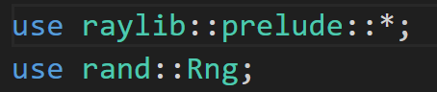
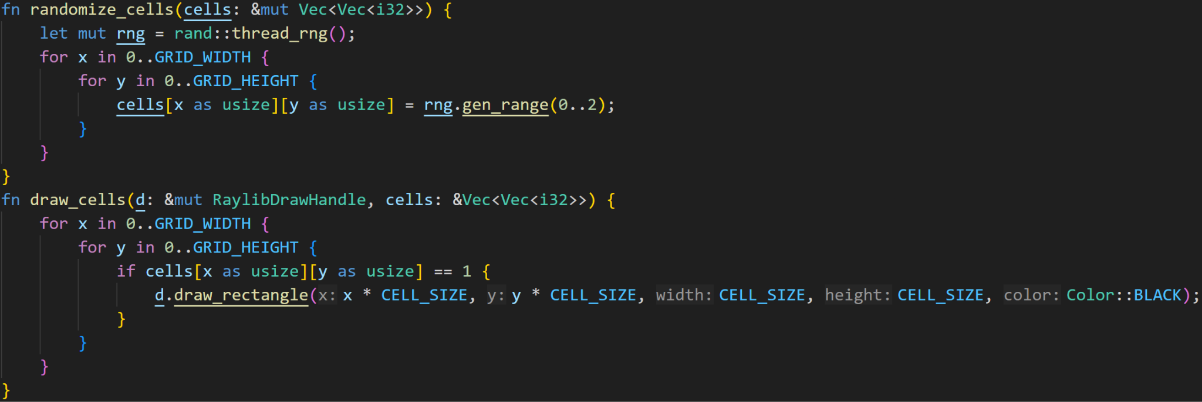
cargo
©Philippe Felix Haupt 2023-2024

Slide 73
cargo
Because I didn’t explicitly use rand::thread_rng, I need to specify the full module path rand::
©Philippe Felix Haupt 2023-2024

Slide 74
cargo
Without use raylib::prelude::*, this type would’ve been
raylib::prelude::RaylibDrawHandle
©Philippe Felix Haupt 2023-2024

Slide 75
cargo
This function implementation is part of rand::Rng, so we need to use rand::Rng
It takes a range, and generates random numbers in that range:
2 is exclusive, else we’d have to specify 0..=2
©Philippe Felix Haupt 2023-2024

Slide 76
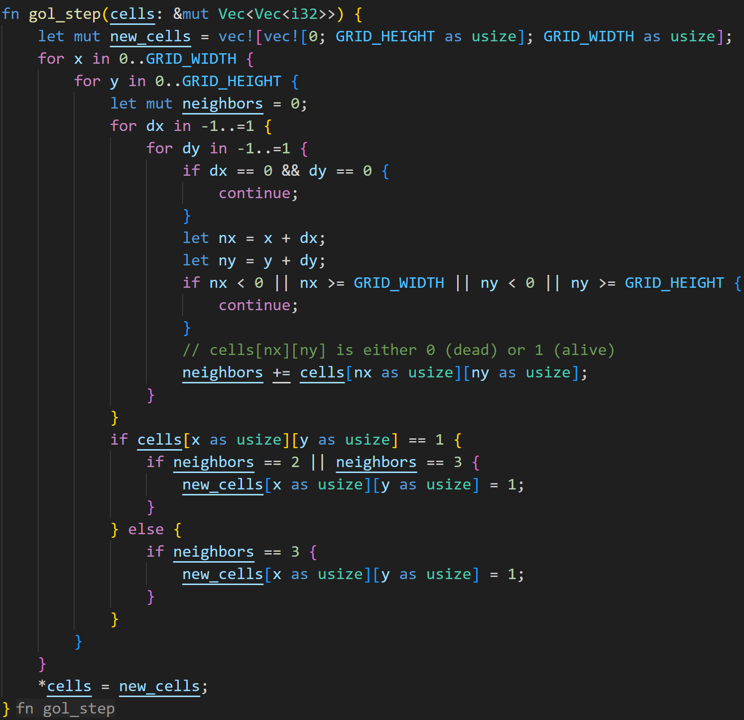
©Philippe Felix Haupt 2023-2024

Slide 77
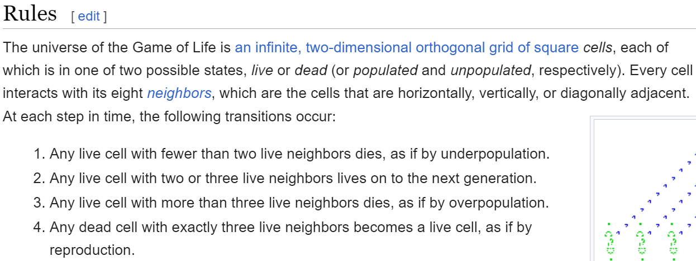
©Philippe Felix Haupt 2023-2024

Slide 78
in theory* :^)
©Philippe Felix Haupt 2023-2024

Slide 79
©Philippe Felix Haupt 2023-2024

Slide 80
©Philippe Felix Haupt 2023-2024

Slide 81
You’re not your own neighbor :)
Out of bounds checking, otherwise we’d index our Vector at the wrong places and crash the program
©Philippe Felix Haupt 2023-2024

Slide 82
©Philippe Felix Haupt 2023-2024

Slide 83
By initializing new cells as dead, we can skip rules 1 and 3
©Philippe Felix Haupt 2023-2024

Slide 84
©Philippe Felix Haupt 2023-2024

Slide 85
Update here
©Philippe Felix Haupt 2023-2024

Slide 86
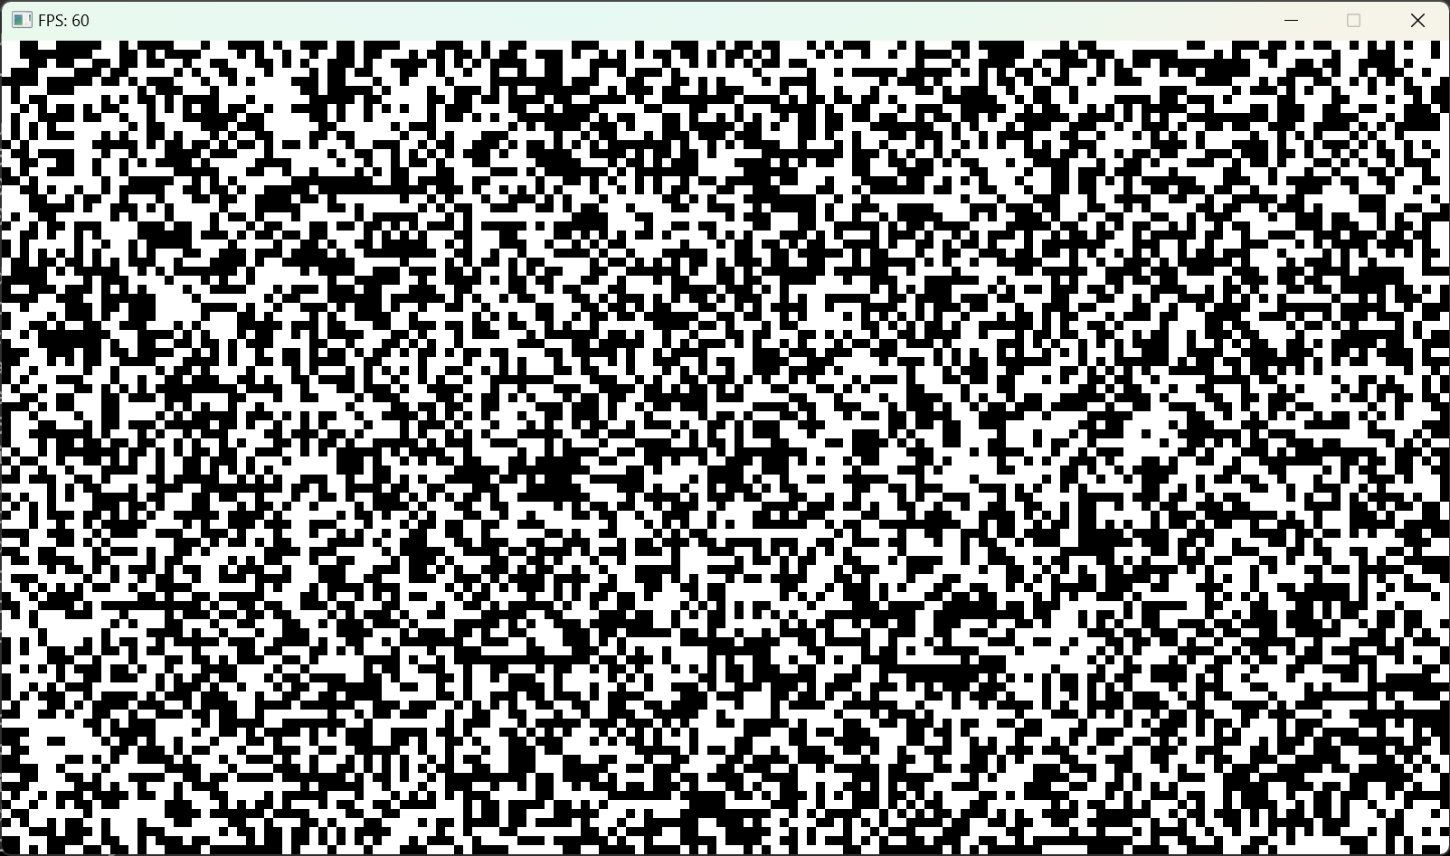
cargo
Initializing with random values
©Philippe Felix Haupt 2023-2024

Slide 87
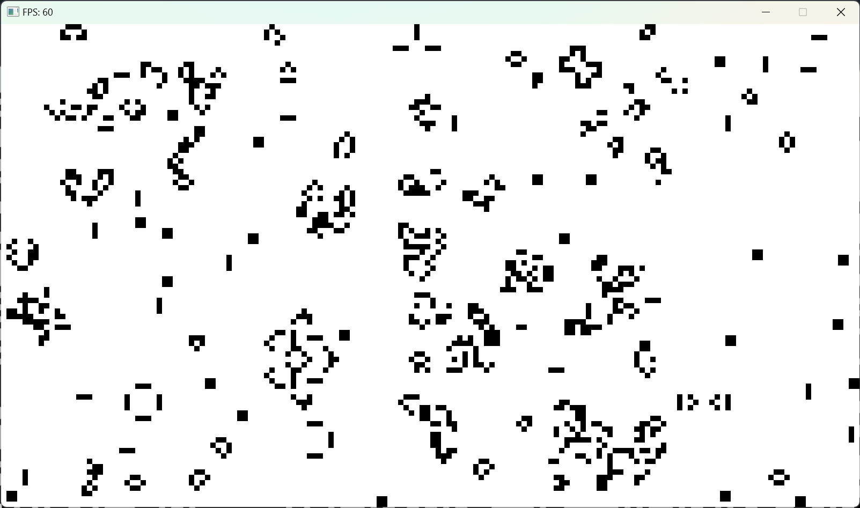
cargo
After letting it run for a while
©Philippe Felix Haupt 2023-2024

Slide 88
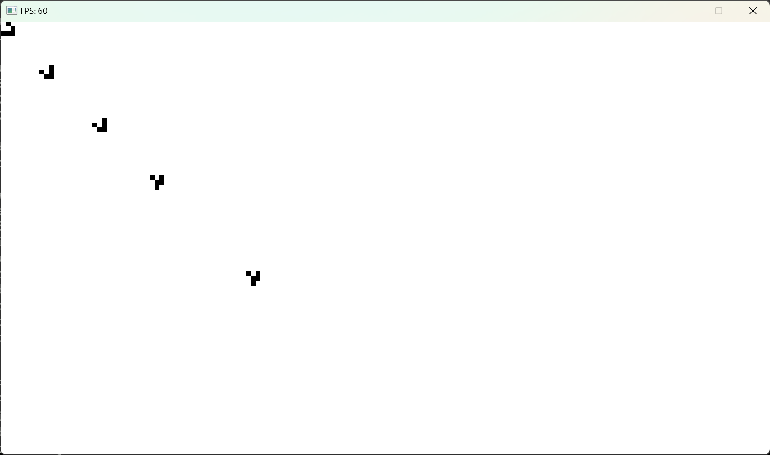
cargo
Even with those simple rules, some interesting patterns emerge:
The glider is a stable configuration that moves diagonally across the screen :)
©Philippe Felix Haupt 2023-2024

Slide 89
Q/A
©Philippe Felix Haupt 2023-2024

